Slide 1
Job Offer For HR Professionals
Internal Resourcing

Slide 2
Job Offer
1

Slide 3
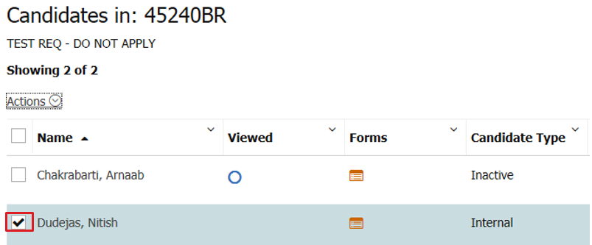
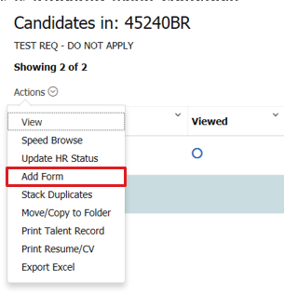
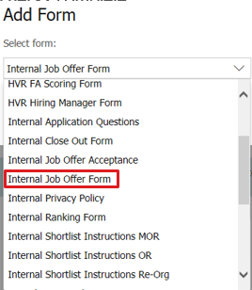
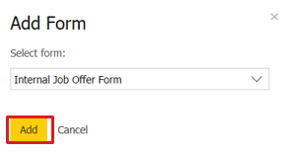
Job Offer
The job offer process is triggered when candidate status is changed to HR checks complete.
In the system, navigate to the candidate to whom the Job Offer will be extended and tick the box beside the candidate name.
In the Actions tab, click Add Form and select Internal Job Offer Form. Click Add.

Slide 4
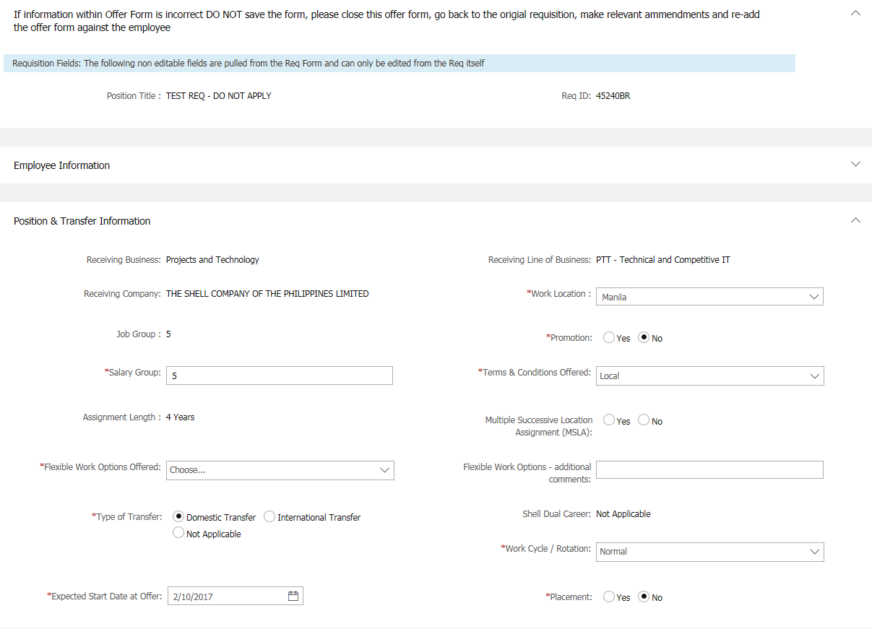
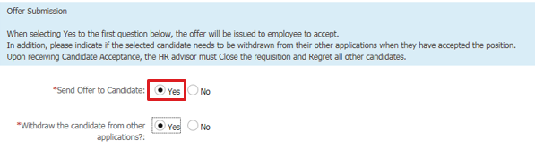

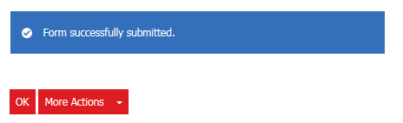
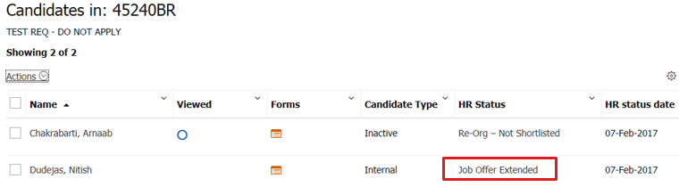
Job Offer
Fill out the required fields which are indicated by the red asterisks.
After filling out the Job Offer Form, ensure that the Send Offer to Candidate field is set to Yes. Click Submit. Form successfully submitted message will show up once the offer has been completed. The status will change to Job Offer Extended.
Note:
If information within Offer Form is incorrect DO NOT save the form, please close this offer form, go back to the origial requisition, make relevant ammendments and re-add the offer form against the employee

Slide 5
Job Offer
Note:
If the Send Offer to Candidate is set to No, the Job Offer form will just be saved on the candidate’s profile and the candidate will not receive an system e-mail regarding the job offer.
Withdraw the candidate from other applications would mean that the candidate will be withdrawn from other applications once they accept the job offer for the requisition.
Before completing the job offer form, HR ensures that all information on the requisition form is accurate and complete, that any noted terms and conditions were met and complied with, and that all necessary authorizations were obtained.

Slide 6
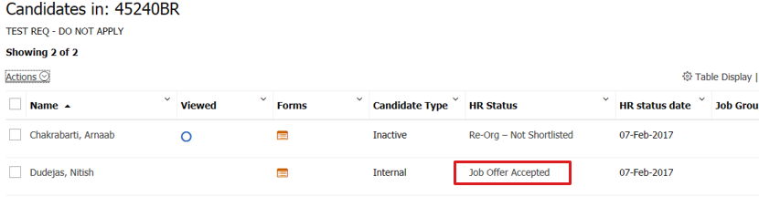
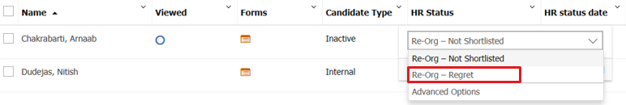

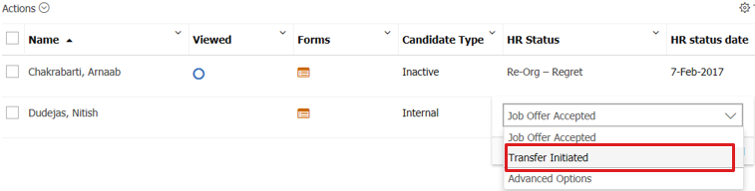
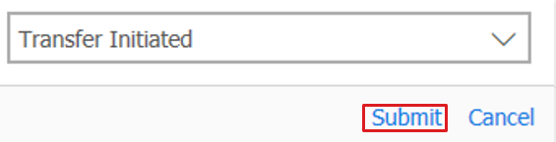
Job Offer
The status will change to Job Offer Accepted once the candidate accepts the job offer. Once the candidate is in Job Offer Accepted status, HR can now proceed with progressing the remaining candidates to the final Regret status.
After the other candidates have been progressed to the final regret status, you may now proceed with progressing the successful candidate to Transfer Initiated status.

