Slide 1
Approving, Posting, Reopening NOV Requisitions
For HR Professionals
Internal Resourcing

Slide 2
Agenda
01 Creating an NOV Requisition
02 Editing an NOV Requisition
03 Closing or Cancelling an NOV Requisition

Slide 3
Creating an NOV Requisition
1

Slide 4
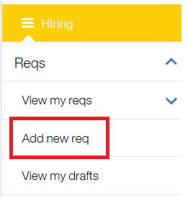
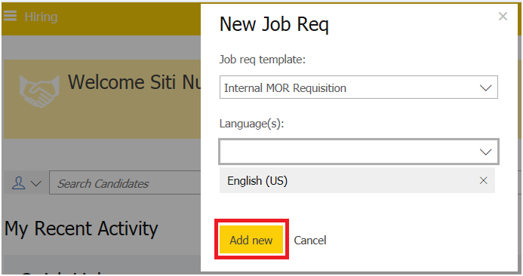
Creating an NOV Requisition
From the Hiring menu, go to Reqs > Add New Req >
choose a) Job req template: NOV Requisition
b) Language (s) from the drop down menu and
click Add New
NOTE:
Open Resourcing support the creation of requisition
in 4 languages: English (US), Dutch, French (Canadian)
and German.

Slide 5
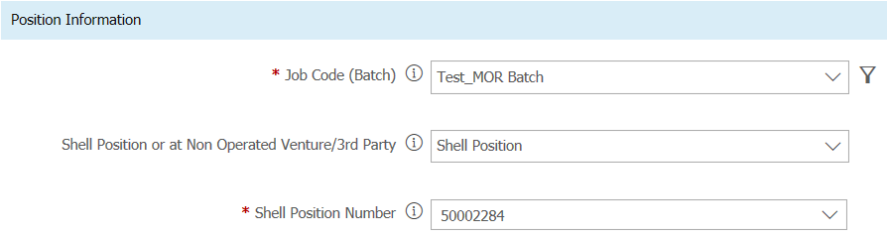
Creating an NOV Requisition
To get started, choose the correct batch from the
Job Code (Batch) menu
Please choose appropriate selection for Position
Information whether it’s Shell Position or
NOV/3rd Party
Please enter Shell Position number
NOTE: Please ensure that you have the Shell Position
ID prior to creating the requisition.

Slide 6
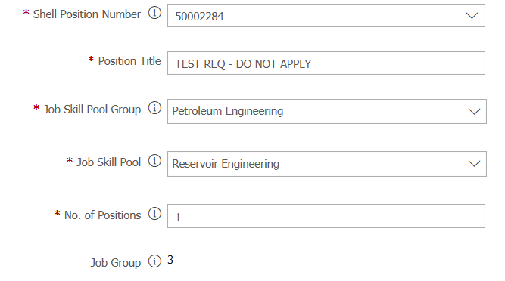
Creating an NOV Requisition
By entering Shell Position number, it auto populates
Position Title, Job Title and Job Group
Please choose appropriate selection for Job Skill Pool
Group and Job Skill Pool
Please indicate number of positions
NOTES:
If you are posting for multiple positions,
please enter the Shell Position Number for one of the
positions in Shell Position Number field and enter
the total number of positions in the No. of Positions field
The HR advisor will have the ability to add the
remaining position numbers during the job offer

Slide 7
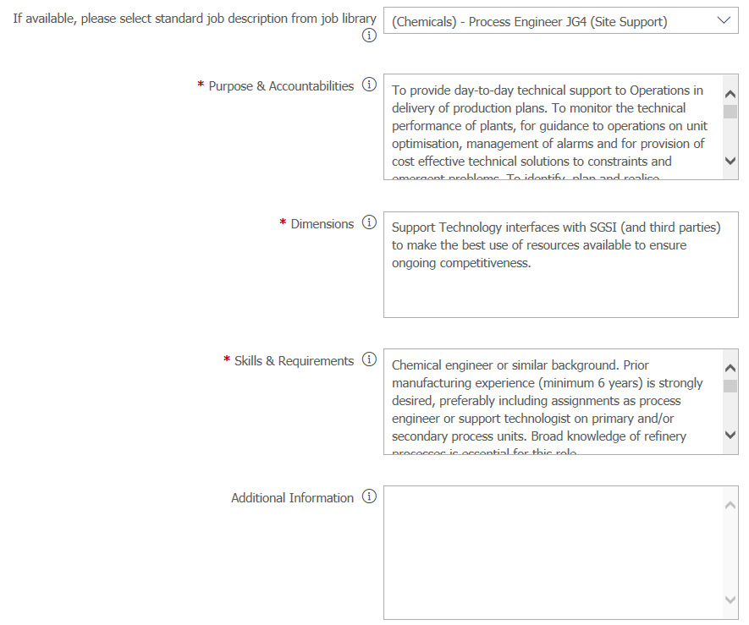
Creating an NOV Requisition
You can choose job description from job library
and it will auto populate the information on Purpose &
Accountability, Dimensions and Skill & Requirements
NOTES:
If you don not see the position that you would like to
use in the job library drop down, please kindly click on
“I” icon as there is another job library in Share Point with
additional information that you can copy and paste into
this req form
As for those auto pre populated information, you can
always edit by clicking and typing in on any field
and hit save
You may also enter Additional Information about the position

Slide 8
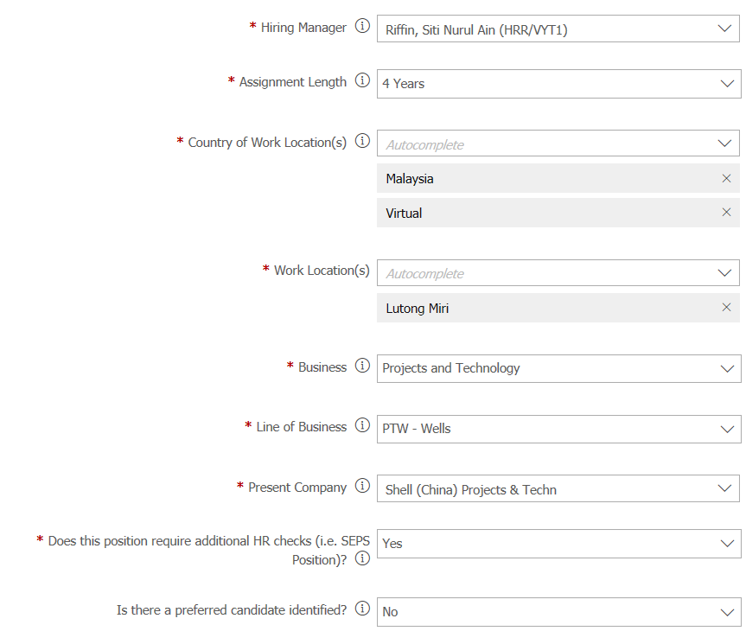
Creating an NOV Requisition
In Hiring Manager field, please enter your own
name
Please fill in the following information on Position
Information as necessary:
Country of Work Location, Work Location, Business,
Line of Business, Present Company, Question on
Additional HR checks, Question on Preferred candidate
NOTE: If posting for a virtual role, please type in
virtual on this field

Slide 9
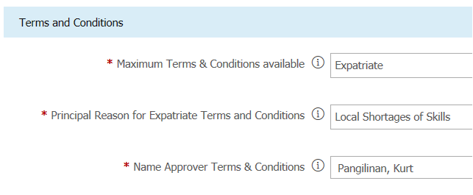
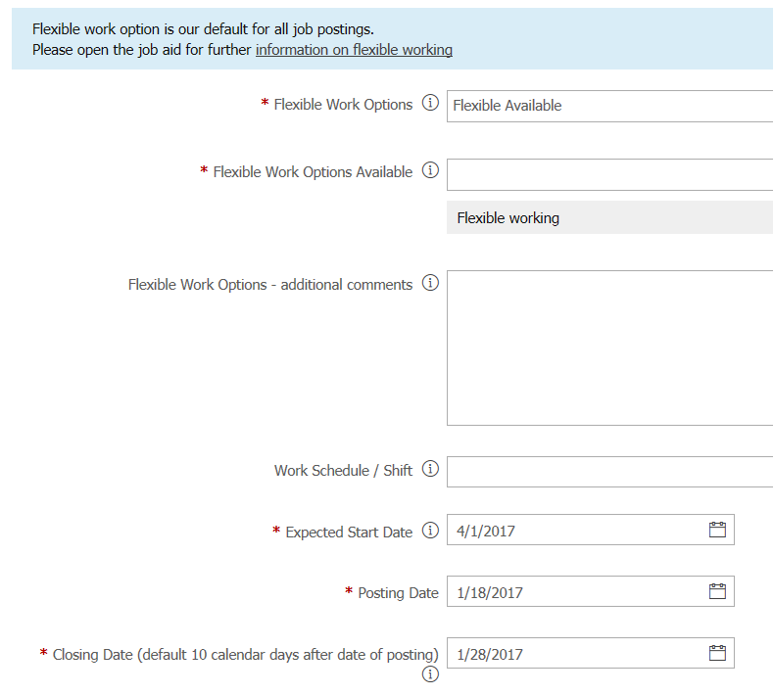
Creating an NOV Requisition
Please enter Maximum Terms & Conditions
NOTE: If you choose Expatriate or STIA, there
will be additional field popup for you to fill in
on Principal Reason and Name Approver
Next, please fill in the Flexible Work Options
and work schedule / shift if any
Please enter the Expected Start Date and
Closing Date
NOTE: Please ensure the Closing Date indicated
in the job requisition is aligned with the Removal
Date that you will be indicated in the next posting
screen

Slide 10
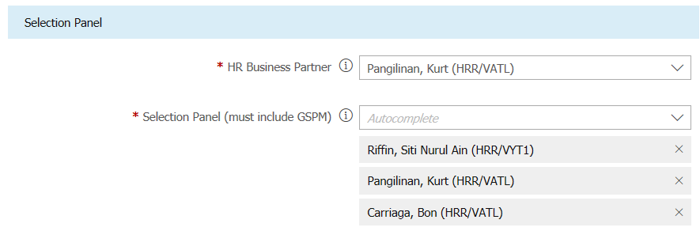
Creating an NOV Requisition
      15. Please enter HR Business Partner Name
      in HR Business Partner field
      NOTE: HRBP is responsible in performing
      HR checks
      16. Next, please enter Selection Panel field
      NOTE:
      Be sure to add HRBP again and the GSPM to
      the Selection Panel field
      Any name entered in the fields HR Business Partner
      or Selection Panel will receive an email notification when
      the job is posted and at key points along the process

Slide 11
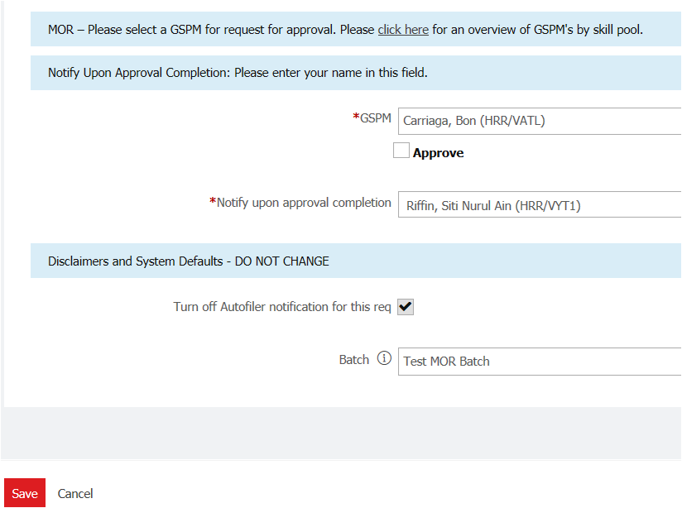
Creating an NOV Requisition
Again, you have to enter GSPM name
for approval and posting purposes
Notify upon approval completion –
Please add in your name so that you
receive notification once GSPM approved
the requisition
Next, on the “Turn off Autofilter notification for
this req” – Please leave it as it is
Batch: Do not change this as it is auto
populate based on what you entered in the
job code field and click Save to proceed

Slide 12
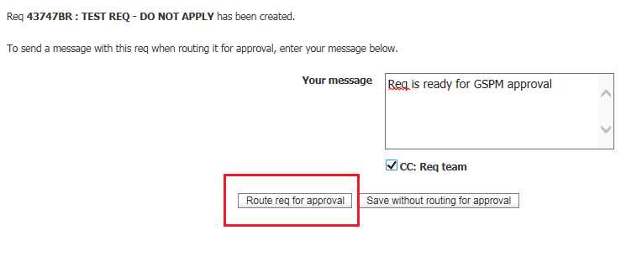
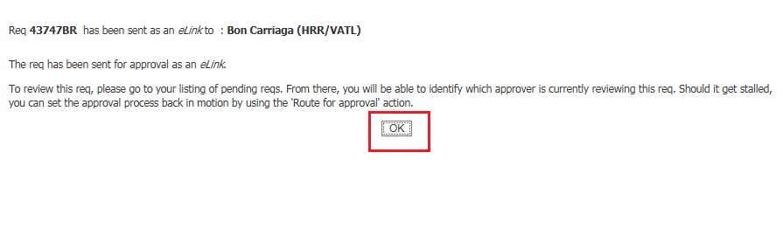
Creating an NOV Requisition
On the next screen, you can add a message
to GSPM and route the requisition for approval.
You may also tick on: CC: Req team so that relevant
notifications will be sent to Req team/Selection Panel
Click on Open Req to continue to the posting
options page
You will receive a confirmation that the req has
been sent to GSPM for approval > please then
Click OK
You have now completed the MOR req creation

Slide 13
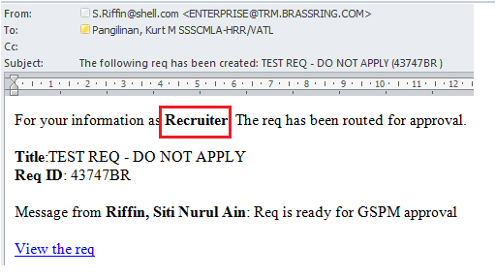
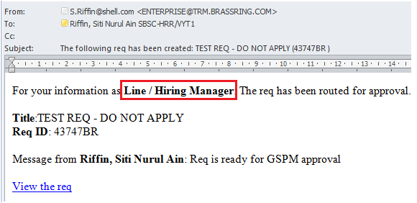
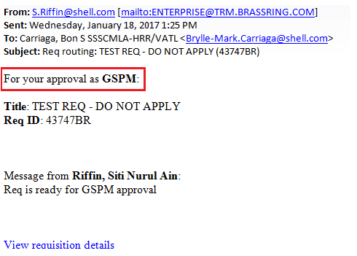
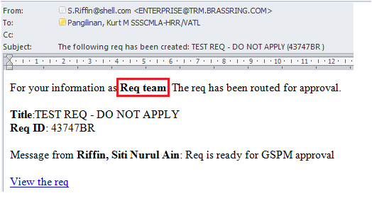
Notification Email
HRBP, GSPM and Selection panel members
will receive a system-generated notification upon
NOV req creation

Slide 14
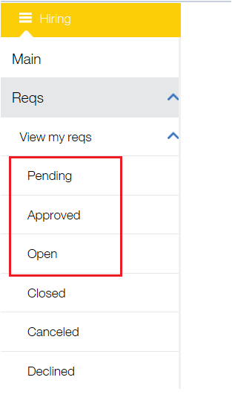
KEY NOTES ON NOVREQUISITION CREATION
The GSPM will receive the notification that you have created a requisition
The GSPM will approve and post the requisition as per the MOR timelines
The requisition will appear under Pending until the GSPM approves it
After approval, the requisition will appear under Approved
Once the GSPM posts the requisition, it will appear under
My open reqs panel

Slide 15
Editing an NOV Requisition
2

Slide 16
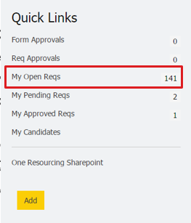
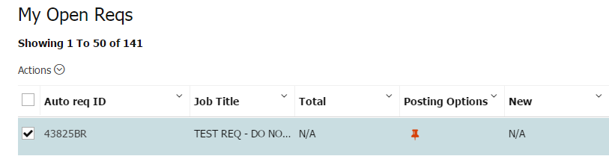
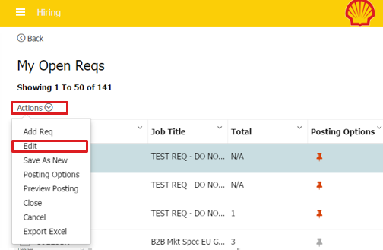
Editing an NOV Requisition
To edit an NOV requisition, go to your OR homepage > Quick Links > My Open Reqs.
Tick the box at the side of the req ID you want to modify, then click the Actions drop down button and click Edit. You may also click the req ID hyperlink to view the requisition information and edit details.
Change the information you want to update. Click Save button once done.

Slide 17

Editing an NOV Requisition
Don’t forget to communicate any major change in the req to the candidates.
NOTES:
Only active (open) requisitions may be edited.
Ideally, editing should occur before the Re-Org Approver has posted the requisition.
An email is sent to the Hiring Manager, Shell HR Business Partner, Re-Org Approver and Selection Panel informing that the requisition has been edited.

Slide 18
Closing or Cancelling an NOV Requisition
3

Slide 19
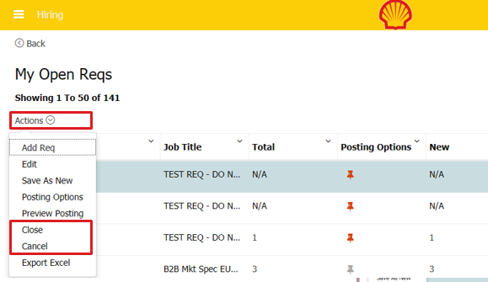
Closing or Cancelling an NOV Requisition
To close or cancel an NOV requisition, go to your OR homepage > Quick Links > My Open Reqs.
Tick the box at the side of the req ID you want to close or cancel, then click the Actions drop down button and click Close or Cancel. You may also click the req ID hyperlink to view the requisition information and cancel the requisition on that page.

Slide 20
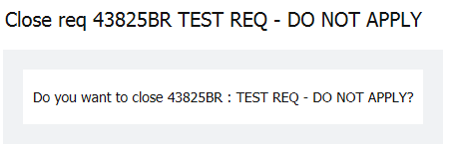
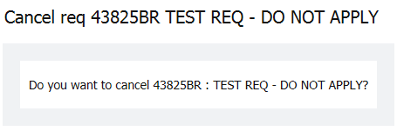

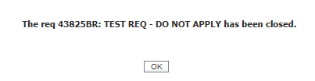
Closing or Cancelling an NOV Requisition
Once you click Close or Cancel, you will receive a pop up window asking you to confirm your action.
Click Yes button at the bottom of the page. Cancel button if you do not wish to proceed.

Slide 21
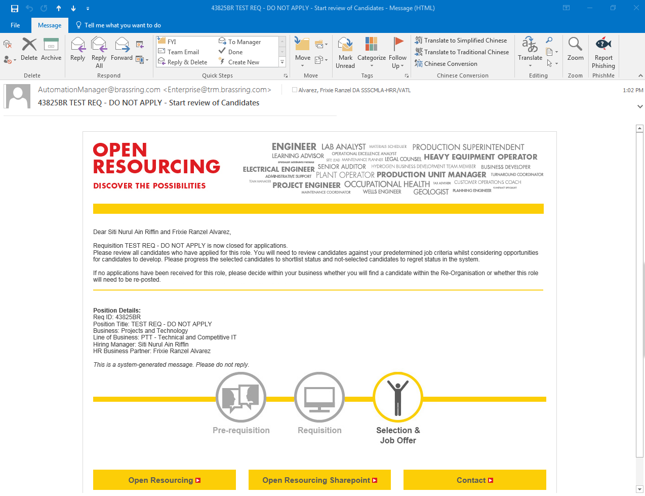
Closing or Cancelling an NOV Requisition
You will receive an email that your requisition has been closed or cancelled.
NOTES:
You may only cancel or close a requisition if the applicants have been moved to the final status. If there is a pending status, the system will not let you close the requisition.
All candidates under your MOR requisition must have one of the following HR Statuses:
Re-Org- Regret
Transfer initiated

